Slide 1

Analysis Considerations
Session 4

Slide 2

Avoid p-Hacking
Notes:
You may have heard of the replication crisis—we now know this to be partly the result of a number of SEEMINGLY INNOCENT but DANGEROUS analytics practices. This has led many a scientific study (even in medicine, oncology research, psychology, etc.) to invalidity.
What are these mistakes, and how can we prevent them?

Slide 3
Remember
p = % of time result occurs by chance
“significant” if p < .05

Slide 4

“p-Hacking”
Systematically “hacking” your data to get p < .05
Adding participants until p < .05
Comparing subgroups until something is p < .05
Trying analysis with/without controls, predictors, etc.
Trying analysis with different estimators / models / transformations
Etc.
Notes:
Why tempting: Easy insights. Big result = good for me

Slide 5
Why It’s Bad?
Sample results are estimates with error
Selecting for big, significant results tends to select for error
Such results replicate / cross-validate poorly

Slide 6
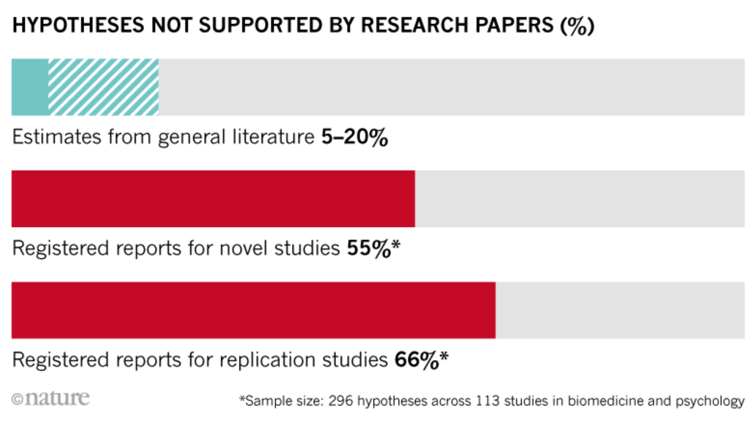
https://www.nature.com/articles/d41586-018-07118-1

Slide 7
https://www.nature.com/articles/d41586-018-07118-1

Slide 8
If you explored the data:
Disclose
Ask
Confirm
How much exploration (rethink reporting?)
Can a case be made against the finding?
Cross-validate in holdout data or replication data
Notes:
Disclose: How much exploration was done (need to rethink reporting?)
Ask: Was there evidence against the conclusion?
Confirm: Test the result with holdout / replication data

Slide 9

Python Exercise

Slide 10
You Need Power

Slide 11
Power
Percentage of time you’ll detect real effects (want 80%+?)
For a given effect size and sample size
Larger effects = more power
Larger sample size = more power
Control via sample size . Big data = good
Notes:
This leads to a problem whereby small effects go undetected. When we filter for only “significant” effects

Slide 12
Caveat
Separate issue from having the right people

Slide 13
If Power is Low
Will miss things (p > .05)
Results not trustworthy
Effect size estimates are imprecise (large CI)

Slide 14
If Power is Low
Will miss things (p > .05)
Results not trustworthy
Effect size estimates are imprecise (large CI)
Always check minimum sample size for SESOI

Slide 15
Python Exercise

Slide 16
A Perfect Storm
Notes:
You may have heard of the replication crisis—we now know this to be partly the result of a number of SEEMINGLY INNOCENT but DANGEROUS analytics practices. This has led many a scientific study (even in medicine, oncology research, psychology, etc.) to invalidity.
What are these mistakes, and how can we prevent them?

Slide 17
Weak power + Weak priors = Few true positives
(poor detection)
(not much there)
(BIG PROBLEM)
Going “fishing”?
Small effects?
Notes:
. Need to cross-validate. Most p-hacked results wont.

Slide 18
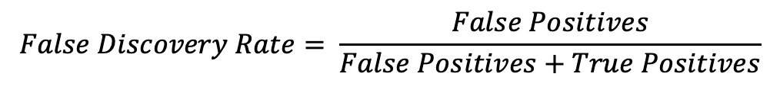
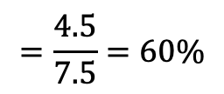
Weak priors: 10% of effects exist
100 Tests
10 Effects Present
90 Effects Absent
Small data (power): only 30% detected
5% false positive rate
Happens often when “fishing” for small effects
3 True Positive Results (p < .05)
4.5 False Positive Results (p < .05)
$$False Discovery Rate= \frac{False Positives}{False Positives+True Positives}$$
$$=\frac{4.5}{7.5}=60\%$$

